Slide 1
NYC Subway Metagenome

Slide 2
What is the microbiome?
"the ecological community of commensal, symbiotic, and pathogenic microorganisms that literally share our body space.” Joshua Lederberg
Bacteria
Viruses
Fungi
Protists

Slide 3
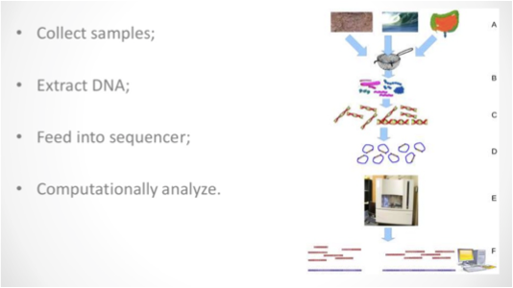
Microbiome analysis concept

Slide 4
History
16S sequencing studies began with Carl Woese in the late 1960s, early 1970s
Environmental DNA cloned into BAC libraries Jo Handelsman & Ed deLong, - 1990s

Slide 5
History II
Major explosion after next gen sequencing technologies introduced in 2005 (454 especially)
2011: Illumina 16S sequencing (Caporaso et al PNAS)
2012 Human Microbiome Project Publication
2016 > 6000 Microbiome publications

Slide 6
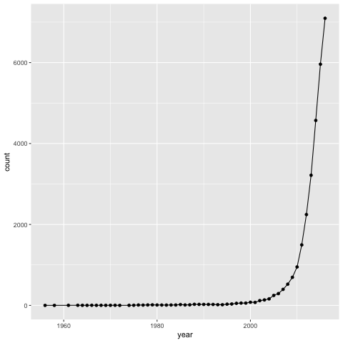
“Microbiome” Publications to 2016

Slide 7
What are the outputs of microbiome research?
Who’s there?
Summary statistics – species richness, diversity, species differences between samples
What are they doing?
Genes , functions
What does it mean?
Ecological community drivers, perturbations

Slide 8
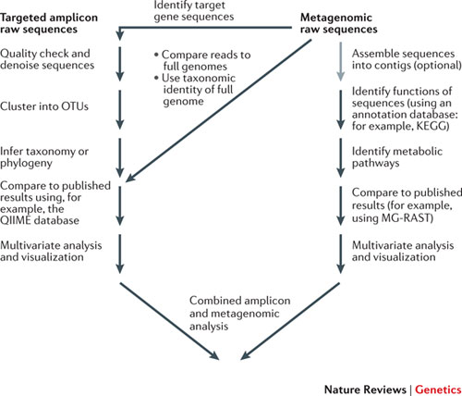
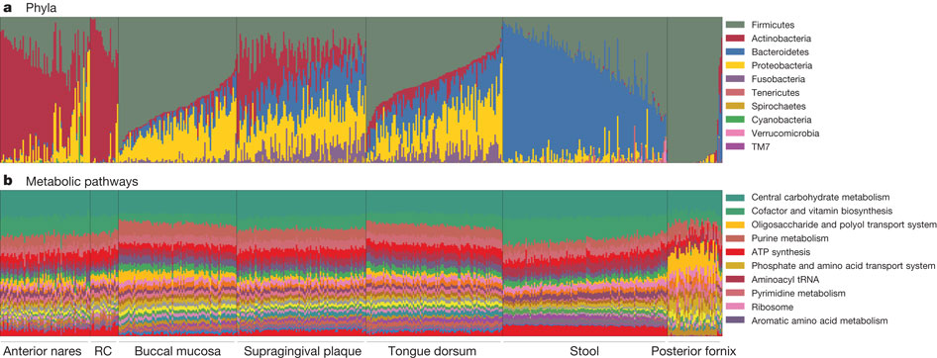
DNA-based microbiome studies

Slide 10
16S

Slide 11
Barcode methodology
Obtain DNA sample
Amplification using conserved primers (can add oligo tags to multiplex)
Compare to sequence database (or can do de novo clustering)
Obtain map of species composition

Slide 12
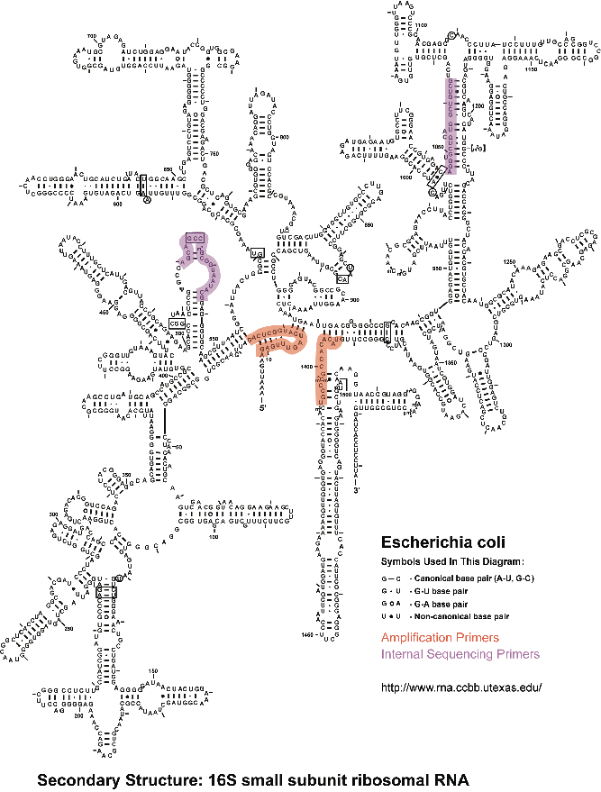
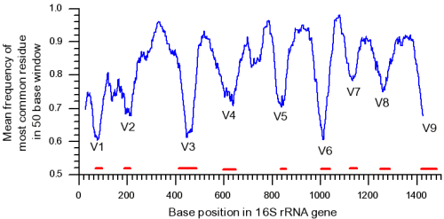
16s rRNA gene analysis: Genomic approach to identify bacteria
16s rRNA gene is universal among prokaryotes
Phylogeny assessed based on conserved and variable regions
Slide courtesy of Julie Segre

Slide 13
OTUs
“Operational Taxonomic Units”
Approximately equal to species, genera etc
Defined quantitativey, e.g >97% DNA identity of nucleotide sequences

Slide 14
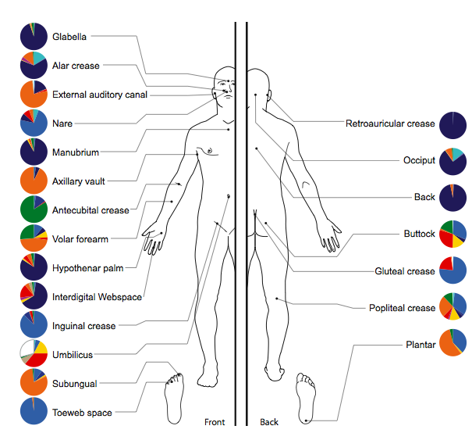
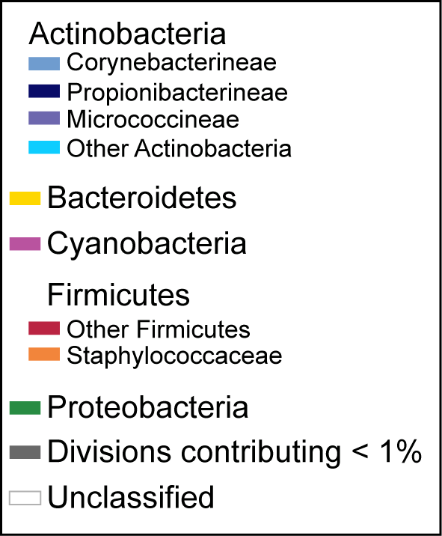
Variation in OTU composition in skin
Slide courtesy of Julie Segre

Slide 15
Comparing microbial communities
What is there?
How much of each species? (alpha diversity)
How do communities differ? (beta - between sample diversity)
What is the species richness? – Total number of species(OTUs)

Slide 16
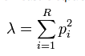
AlphaDiversity
Many measures of diversity, two common ones
Shannon Diversity
Simpson Diversity
Notes:
The point is that “diversity” is a diversly measurement measurement

Slide 17
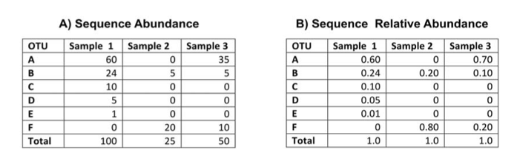
Example
Morgan, X. C. & Huttenhower, C. Chapter 12: PLoS Comp Biol 8, e1002808 (2012).
Notes:
What is the richness

Slide 18
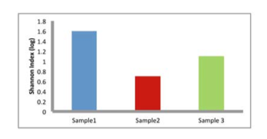
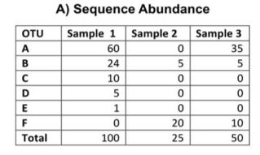
Shannon Diversity Calculations

Slide 19
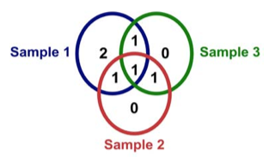
Simple Between-Sample Diversity
(Based on conserved taxa)

Slide 20
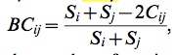
Another Between-Sample Diversity measure
Bray-Curtis
^{Where S}_{i} ^{and S}_{j} are the number of species in populations i and j, and C_{ij}is the total number of species at the location with the fewest species
Notes:
What is the Bray Curtis?

Slide 21
Principal Component Analysis (PCA or PCoA)
Ordination method to explore data in distance matrixes
Output largest dimensions of variance
Commonly, the two-three largest dimensions are plotted
See: https://www.youtube.com/watch?v=BfTMmoDFXyE

Slide 22
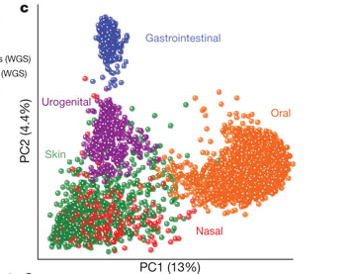
Beta diversity based PCA
Percentage variance

Slide 23
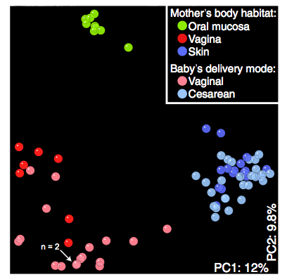
Comparing communities: Microbiome of vaginal versus caesarian birth
Dominguez-Bello, M. G. et al. Proceedings of the National Academy of Sciences 107, 11971–11975 (2010). 2010 PNAS

Slide 24
Development of the infant microbiome
http://www.youtube.com/watch?feature=player_embedded&v=Pb272zsixSQ

Slide 25
16S Sequencing
Cheap
Easy
Portable
PCR bias
Variable regions give variable answers
Only tells you which organisms are present & abundance
Does not explain much of the variance of the data

Slide 26
no 16S DNA for viruses, fungi, protists, etc

Slide 27
Metagenome studies

Slide 28
DNA-based microbiome studies

Slide 29
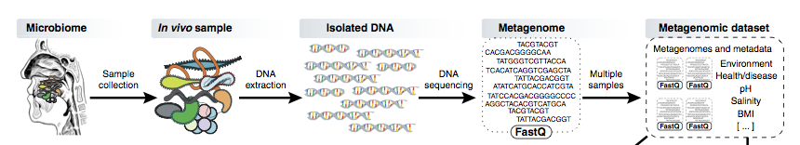
Metagenome de novo assembly

Slide 30
Metagenomics - Human DNA removal
Different tissues contain different proportions of human DNA
Stool < 1%
Throat 75%
Saliva 80%
Anterior Nares 82%
Mid-Vagina 96%
The HMP Consortium,. Nature 486, 215–221 (2012).

Slide 31
Assigning OTUs to metagenome sequences
Can just use 16S sequences (however, only a small portion of the data)
Use all the sequence data
Taxonomy tree traversal approaches: BLAST, then map all hits to common ancestor
Use reference genomes

Slide 32
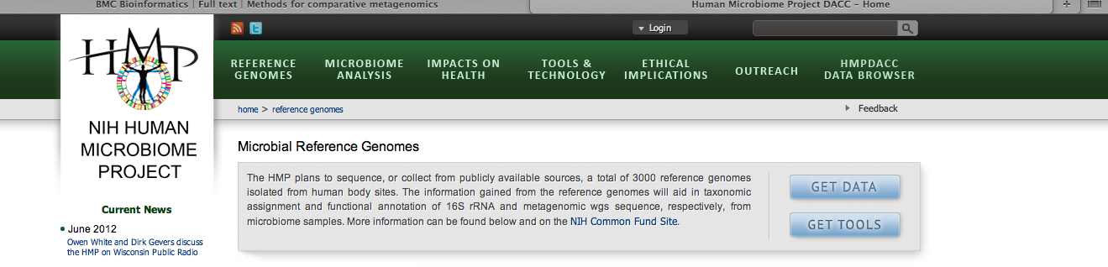
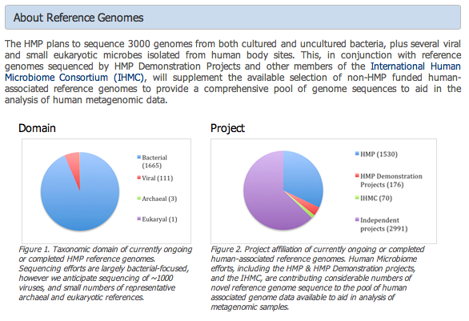
Reference Genomes

Slide 33
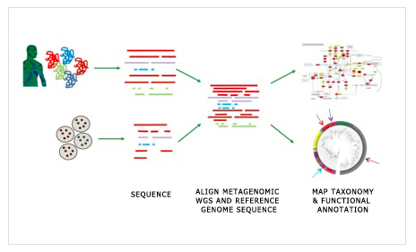
Mapping to reference genomes

Slide 34
Functional annotation of metagenomic sequences
Compare metagenomic sequences to large databases of metabolic annotations
Carriage of microbial taxa varies while metabolic pathways
remain stable within a healthy population.
C Huttenhower et al. Nature 486, 207-214 (2012) doi:10.1038/nature11234
Structure, function and diversity of the healthy human microbiome

Slide 35
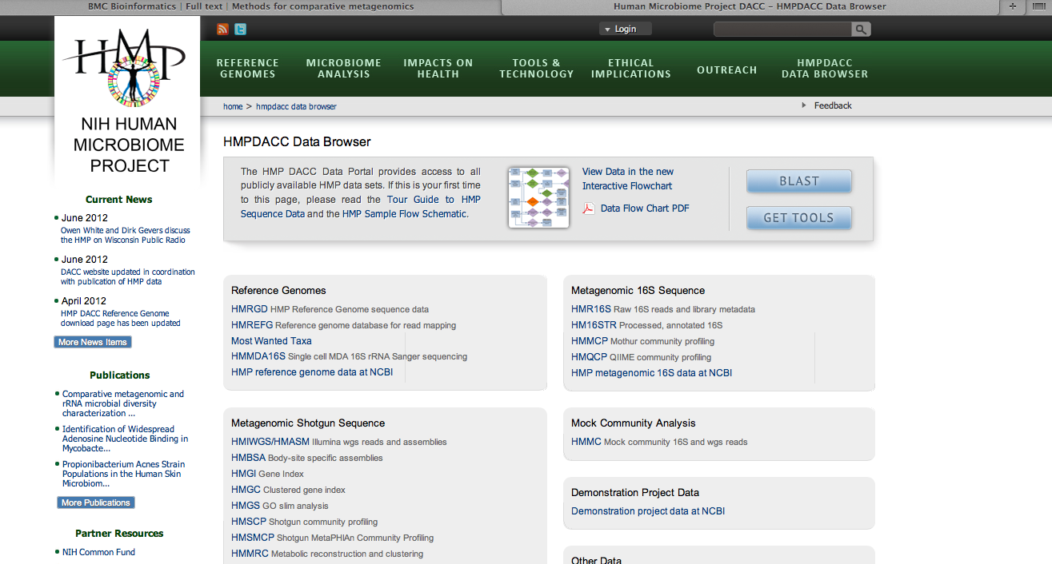
Human Microbiome Project

Slide 36
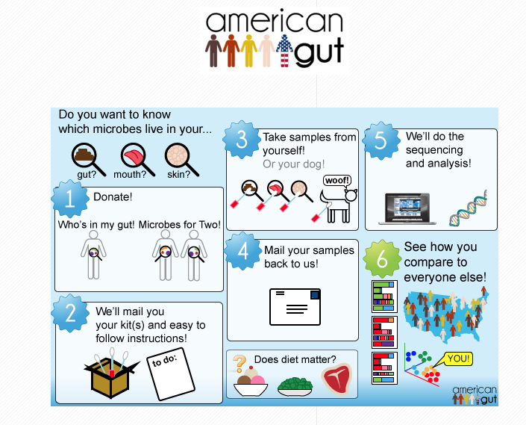
American Gut
http://humanfoodproject.com/americangut/

Slide 37
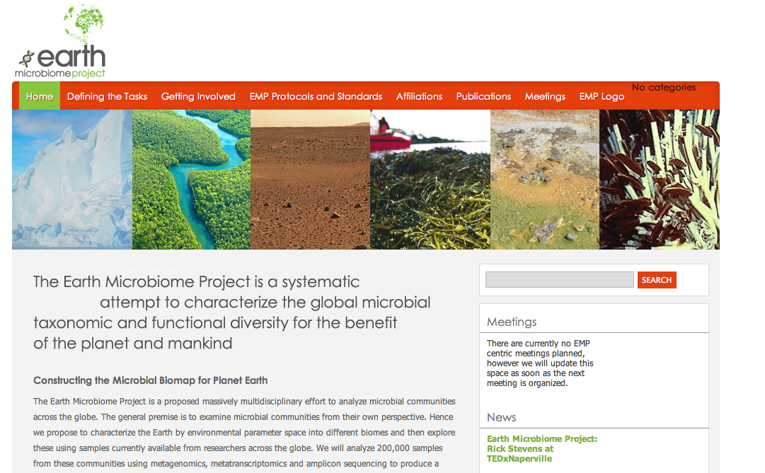
Earth Microbiome Project

Slide 38
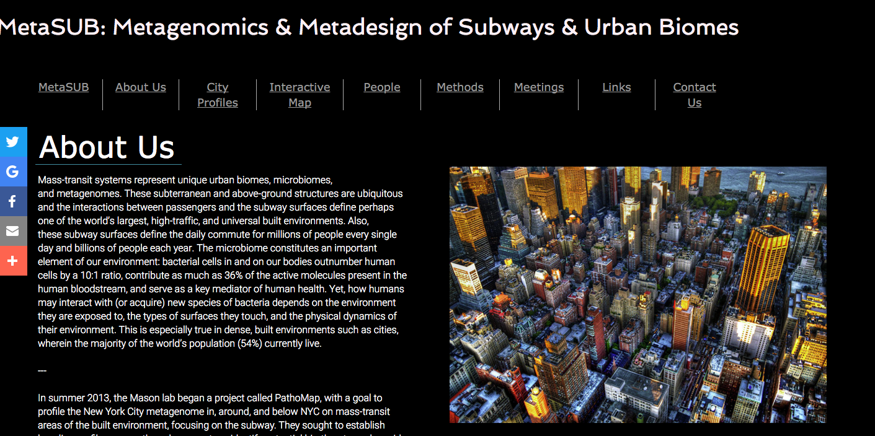
metaSUB
www.metasub.org/about-us.html

Slide 39
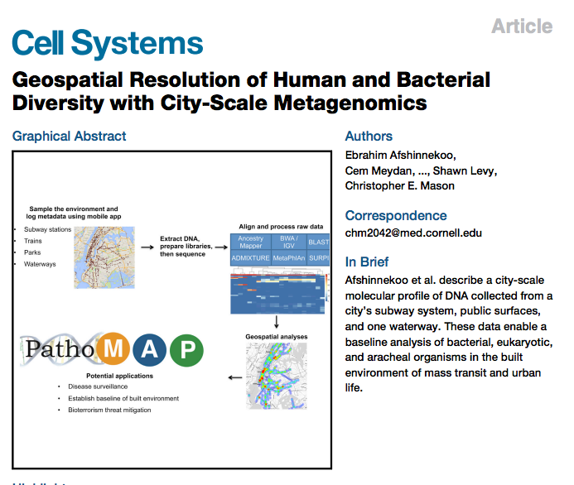
NYC subway analysis

Slide 40
Study design
Sequenced environmental DNA from surfaces across entire NYC subway (1,457 samples)
Recorded GIS information on mobile Apps
An amazing public dataset

Slide 41
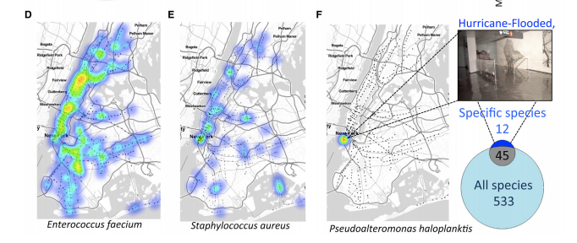
GIS of bacterial abundance

Slide 42
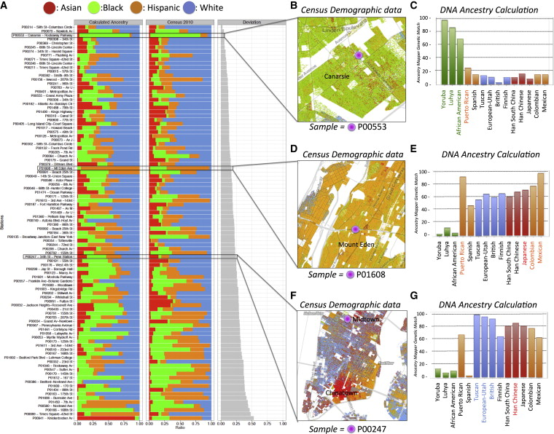
Human DNA Map of NYC

Slide 43
Claims about anthrax and plague
“Although evidence of B. anthracis, Y. pestis, …. was found on the subway system in multiple stations, the results do not suggest that the plague or anthrax is prevalent … ”
“This finding further supports the notion that humans have interacted (and potentially evolved) with their environment in such a way that even low levels of … (plague) or ... (anthrax) will not necessarily confer a risk of acquiring these pathogens. “

Slide 44
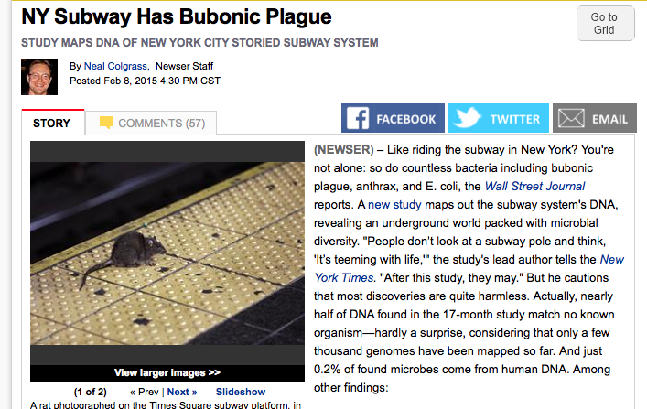
Which became ..

Slide 45
Were the claims true?
In short, no.
Why?: the software used was not specific enough to distinguish from non-pathogen background

Slide 46
This practical
Aims:
Get used to handling real data sets
Compare results from different pipelines
Munge Excel

Slide 47
How Kraken works

Slide 48
Metagenome shotgun sequencing

Slide 49
Problem:
Each read (or paired read set) could come from a different organism
How to associate reads with species (or other taxa)

Slide 50
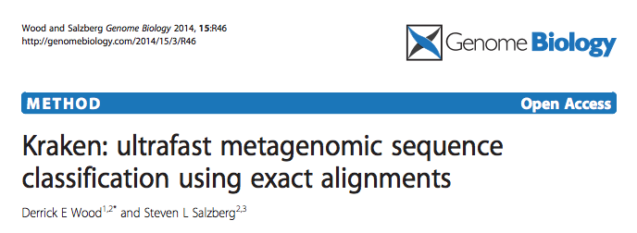
Kraken
Matches sequence of each read against a database associated with taxonomic assignments

Slide 51
Kraken
Matches sequence of each read against a database
Uses k-mer matching
Alignment based methods (e.g BLAST) are too slow for the size of the database (all organisms) and the query database (millions of reads)

Slide 52
What are K-mers?
Component text substrings of a sequence
“K” refers to a number, e.g 4-mer or 346-mer

Slide 53
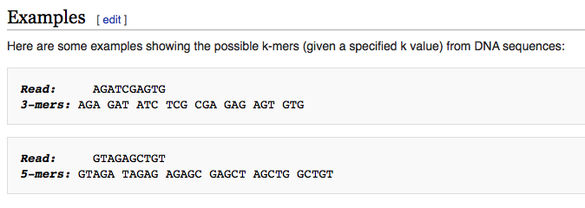
What are K-mers?
Wikipedia

Slide 54
How Kraken works (1)
Build a representative database of genomes across the tree of life
Extract all k-mers
List k-mers by the taxa they are found in.
Note the last common ancestor of each k-mer

Slide 55
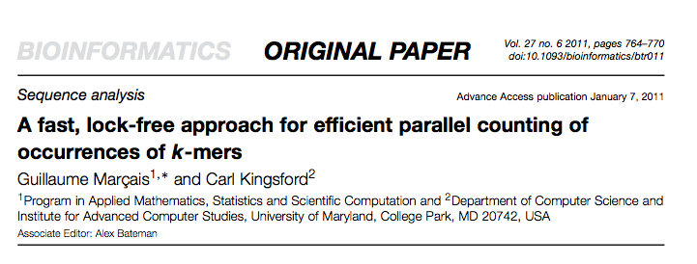
Jellyfish

Slide 56
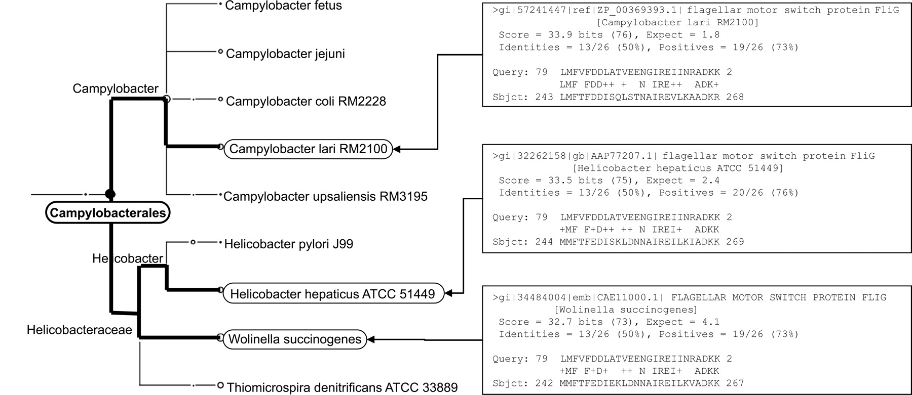

Assigning Last Common Ancestor
Huson D H et al. Genome Res. 2007;17:377-386
Copyright © 2007, Cold Spring Harbor Laboratory Press
Notes:
On the right, we list the three BLASTX matches obtained for a specific read r from the mammoth data set, to sequences representing Campylobacter lari, Helicobacter hepaticus, and Wolinella, respectively. The LCA-assignment algorithm assigns r to the taxon Campylobacterales, shown on the left, as it is the lowest-common taxonomical ancestor of the three matched species.

Slide 57
How Kraken Works (2)
For each read of a query, decompose into k-mers
Find LCA of each k-mer from database
Score most probable assignment of each read based on all the k-mers

Slide 58
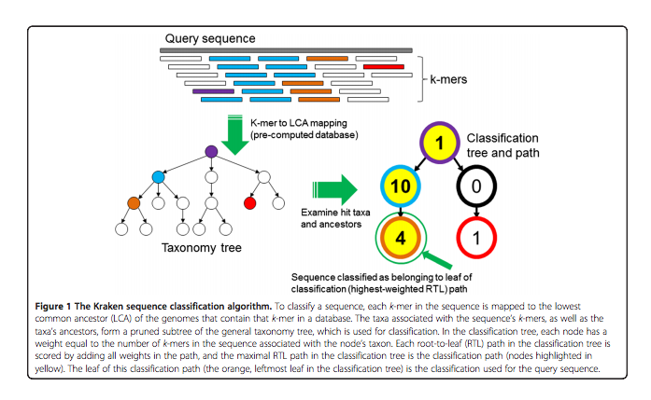
Kraken scoring
1. Map K-mers in database to taxon tree

Slide 59
Kraken scoring
Assign to a taxon based on weighted scoring method

Slide 60
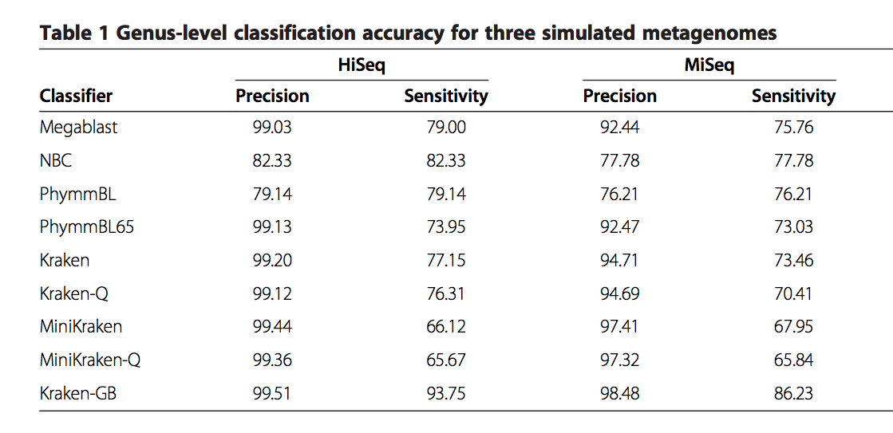
Test results

Slide 61
Metagenome assignment
https://github.com/IBS574/metagenome_assignment/blob/master/metagenomic_exercise.md

